Slide 1
Problem Definition Workshop
Get Care Initiative
Alexis James
alexis@adhocteam.us
Caitlin Weber
caitlin@adhocteam.us
August 13, 2019

Slide 2
Agenda
Introductions
Research Findings Presentation
Activity: What is our North star?
Activity: Gaps & Priorities
Break
Activity: Facts & Assumptions
Activity: Building the Problem Statement(s)
Wrap-Up

Slide 3
Introductions

Slide 4
Veterans choose VA for easy access, greater choices, and clear information to make informed decisions.
VA 2018 - 2024 Strategic Plan - Strategic Goal

Slide 5
About today
Be technology free.
Avoid jumping to solutions
Ask questions
We may need to put items in our “Parking Lot”.

Slide 6

Goals for Today
Build Consensus
Challenge Assumptions
Generate questions for Veterans
Build our Problem Statement(s)
Establish Scope for this engagement
Schedule prototyping workshop

Slide 7
Research Findings

Slide 8
Veterans have access to countless types of care services, making it complicated to know what kind of care to access and how to access it.
Notes:
We started our conversations with all of you early last week with this idea:

Slide 9

Research Method
Review of previous research
VA ecosystem exploration
13 Stakeholder Interviews
Area perspectives
VAOS
MHV
Telehealth
VA.gov
Connected Care
Implementation perspectives
Directors of entire segments of the VA
Doctors practicing medicine within the VA
Technologist
Product owners
Communications experts
Systems experts

Slide 10
Have we tried this before?
Access.va.gov
explore.va.gov
vets.gov
MHV
VA.gov
Notes:
Overall, we mostly heard that a solution to this problem hasn’t really been attempted yet.
We did hear about a few attempts framed mostly around consolidating access to links, but not necessarily around removing the friction between understanding and using the various methods of care.

Slide 11
Why is now the time?
We’re late and we need to fix it.
It’s only recently that we’ve been able to offer so many different types of digital services. It’s now time to bring those experiments together.
This is the next innovation layer where healthcare will advance. The generational timing just seems right.
EHR was one level
Genetics is a level
Patient generated data
Digital Health is also next.
Notes:
We heard a little pessimism, but mostly optimism about why now is the right time

Slide 12
We streamline things on the parts where we’re involved. If we’ve maximized that opportunity, we need to step back and think about other ways to make things work better together.
- Paraphrase of a stakeholder
Notes:
The other thing we heard was this idea:
[Slide Text]
This idea can be called Service Design.

Slide 13
Service Design choreographs process, technologies and interactions within complex systems in order to co-create value for relevant stakeholders.
- Birgit Mager, Service Design Network
Notes:
We look at services as something that crosses implementation channels (digital tools, call centers, kiosks, in person care, business processes and even policy). We often find that each one of those things is well optimized, but the connections between those things are lost in the cracks.
Y’all! We have the opportunity to influence a service design problem and that’s incredibly exciting.

Slide 14
Veteran Characteristics
Who can benefit the most from this initiative?
Focus on the Veteran
Notes:
Frequency of interaction with the VHA

Slide 15
Veteran Characteristics
8-9 million Veterans using VHA services
Active and non-active duty
Service and non-service disabled
Men and Women
Young and old
Technologically and non-technologically inclined
ALL.
Notes:
For now we are solely focused on the Veterans inside of the system, we are not focused on those eligible but seeking care elsewhere. However we firmly believe that a positive byproduct of this work will be to attract additional eligible veterans to the system. Mention family & caregivers.

Slide 16
Service Design and Human Centered Design (HCD) witnesses the needs of those with the most extreme experiences. By designing for people at both ends, we build for those in the middle as well.
Traditional research and design captures the greatest number of customers by designing for the average experience, this this ignores those that have the most extreme needs
Number of people
Average
Novice
Expert
Understanding
Notes:
So how do we impact all veterans within the system?
One of the concepts of service design and a principle of Human Centered Design is that by addressing the needs of those on the periphery we will by default support those in the middle.
Which goes against traditional approaches which focus on capturing a majority of an audience by designing for the average user.
[Koolaid example]

Slide 17
Veterans experiences with VHA
Number of Veterans
Average
Yearly visits
Frequent & critical care
Frequency and urgency of Interactions with VHA
Notes:
In our case we want to focus on number of interactions with the VA. It’s not about age or technology level.
From the once a year primary care visit to the Veteran juggling multiple health issues.

Slide 18
North Star
Long term vision
Based on your understanding of the landscape how do you define the North Star?
Mission statement from the future
Big, bold, impactful, attainable
Builds consensus
Drives strategy
Iterate until we make it

Slide 19

Begin with the end
What does success look like?
Refine the statements presented.
Think about a future state we would like to achieve.
This statement will drive all future action.
Where are we heading?
5 min
Notes:
Combine and refine these statements as a group into one North Star statement that will guide future work as part of this initiative. Use the large pink stickies.
Think of the human centered design principles presented
Present back with reasoning.
Refine across groups for 1 statement

Slide 20
North Star Statement*
VA delivers an intuitive, accessible and consistent experience in a personalized and engaging platform to enable Veterans and their caregivers to manage their health and well-being.
*Created in Workshop

Slide 21
Pain Points
What issues are Veterans encountering?
What issues is the VHA encountering?
What issues are providers encountering?
Where can we improve?

Slide 22
VHA is managing high call volume
Many Veterans prefer face to face interactions.
Veterans are not aware of online services.
Veterans do not trust online services.
Not enough call center staff.
Veterans are calling for items that could be handled online.
[New] Online service attempting to be used experiences multiple offline events
[New] No online chat offering (Beta is in pilot.)
[New] Large amount of password reset calls

Slide 23
Some VHA resources are over utilized (providers, call centers, etc…)
Missed appointments
Walk-ins
Unnecessary (prescription refills) appointments
High call volume
High appointment volume
[New] Underutilized tools to ease access, like Video Visits (VVC)
[New] When confused, Veteran default to calling
[New] Cerner implementation, will mean call staff can no longer submit on behalf of Veterans.
[New Template Management not accounted for in virtual care

Slide 24
Veterans are missing appointments
Call wait-time to cancel is high
Veterans can forget about upcoming appointments
Veterans may not have access to reliable transportation
Wait time between making appointment and appointment date is high
Medical issue resolves itself
Veterans are unaware of online cancelation

Slide 25
Veterans encounter inconsistent information
Complicated Back-end
160 Data Sources (for appointments)
Not enough training
Call center employees are not technical/clinical
VAOS and My HealtheVet are not synced
[New] Communication of modernization to all employees (training, preparation, awareness)
[New] VAMC sites deliver inconsistent experiences but VAMC sites are often “My VA home”.

Slide 26
Veterans and caregivers are missing out on available resources
Veteran awareness is low
Misinformation about what tools can be used for
Provider awareness is low
Web placement
Too many other items competing for Veteran attention
Veterans don’t come in with a shopping list. They come with an immediate need
[New] Unclear what is covered under VA healthcare RE: seeing a non-VA doctor
[New] Veterans may have digital/internet bandwidth issues.
[New] Video chat authentication (pilot)
[New] Caregiver not factored into health modernization activities
[New] MHV requires in person authentication.

Slide 27
Veterans are navigating some clunky systems
Getting access to systems is complicated
Some tools can lead to dead ends, like finding a facility’s address.
Choosing a call center and navigating phone trees are complicated.
Personalized data is managed in multiple places
Secure messaging has glitches
Offerings are in many places and there are more coming.
[New] Feel lost part way through using a website/service
[New] Tech infrastructure not up to par with needed modernization
[New] Veterans can feel lost part way through using a website/service
[New] No consistent CRM service being used across the VA
[New] Awareness of digital tools
[New] MHV requires in person authentication

Slide 28
Consolidated Veteran health records are not easily shared/managed electronically
Caregivers don’t have access to records
Providers can’t necessarily share records between sites
Sharing records between Community Care and VA network will be difficult
Coordination between DOD, Community Care and VA health

Slide 29
Veterans encounter care that does not support their needs.*
Help desks not equipped to help Veterans with certain disabilities
Call center employees are not technical/clinical
Lack of resources (e.g. health hubs) to train Veterans on digital tools, and to train providers on incorporation of these tools into clinical practice
Lack of incentives for providers to recommend digital tools to patients
Experience is not personalized
*Created in Workshop

Slide 30
There are/will be multiple tools to accomplish the same task*
CERNER, VISTA, Community Care
How will a Veteran know which one to use?
Lack of evidence to show that digital tools are safe and effective (important for providers to know)
Confusion over which tool(s) to use or recommend particularly when they have overlapping functionality
Clinical adoption while trying to implement and learn Cerner
Cerner introduces duplicate tools & complicates wayfinding
How do I keep CERNER, VISTA, Community Care straight?
*Created in Workshop

Slide 31
Type of care offered by VA is not organized in a coherent way*
Advice, Appointments, preventive care, urgent care, emergency care
At what point in my journey to complete a task do I decide what kind I need?
Tools for managing care not well organized
Prepare for visit
Manage tasks
VAMCs work differently from each other.
*Created in Workshop

Slide 32
Veterans don’t come in with a shopping list they come with an immediate need.
- Paraphrase, stakeholder interview

Slide 33
Filling the Gaps
Are there examples of these pain points that should be added?
Is there a theme that’s missing
Review and add additional pain points and themes for consideration.
5 min
Notes:
Take X minutes to think about any major pain points that may be missing from our board. Add it to one of our post-its and place on the wall.

Slide 34

Autonomy vs. Impact
How to:
I’ll hold up each pain point at the center.
Tell me if it’s higher, lower, left or right!
Autonomy
How much control do we have over improvements?
Impact
How much does it move us towards our North Star?

Slide 35
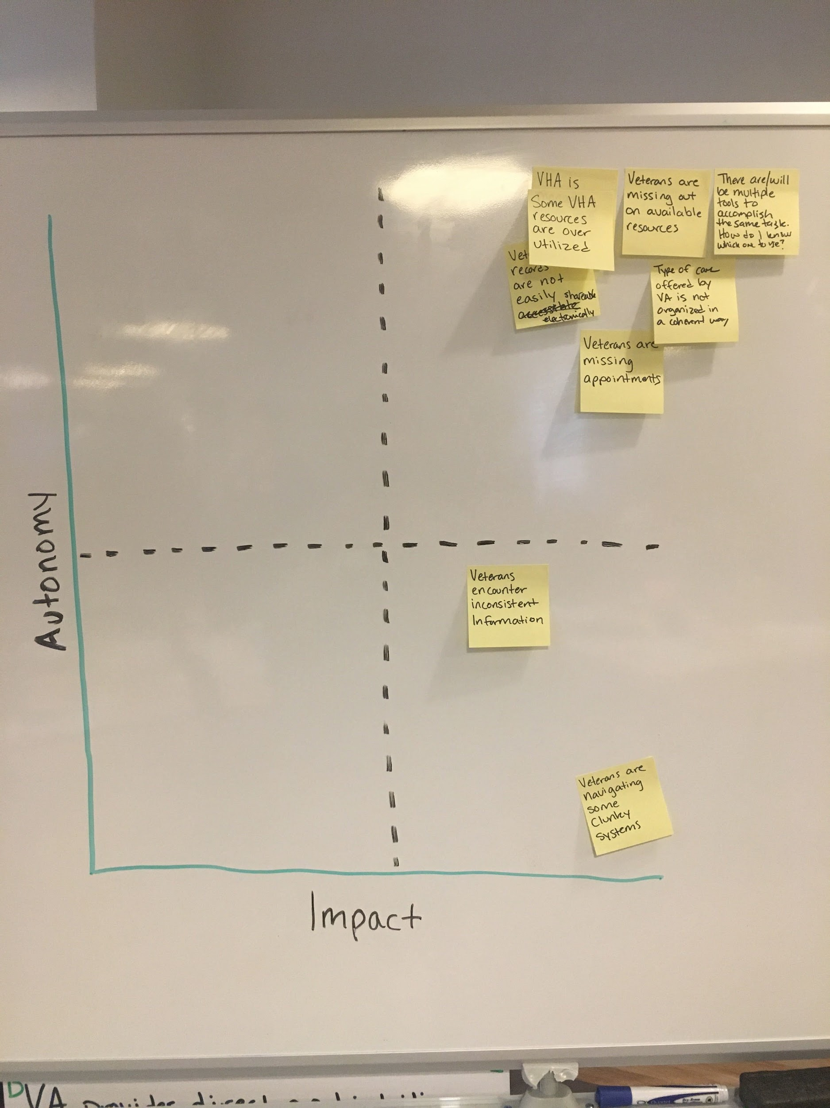

Slide 36
Break (10 minutes)

Slide 37
Time to Vote
If we address these paint points, will it...
...have a significant impact on Veterans’ experiences?
...allow us to build on the idea to get closer to the North Star?
Use your dots to prioritize pain points.
5 min
Notes:
Each person gets X number of dots
X number with most dots ‘win’

Slide 38
Priority List*
Type of care offered by VA is not organized in a coherent way.
There are/will be multiple tools to accomplish the same tasks.
Veterans are missing out on available resources.
Some VHA resources are overutilized (e.g. call center volume)
Veterans are missing appointments.
Veterans encounter inconsistent information
Consolidated Veteran health records are not easily shared/managed electronically
Veterans are navigating some clunky systems
[RESOLVED] Veterans encounter care not qualified to support their needs
*Created in Workshop
Notes:
Completed in real time. Do recap and regain consensus. These pain points will serve to guide our conversations with veterans and drive prototype generation in our next workshop.

Slide 39
Veteran Interviews
What perspective do we want to hear from Veterans?
Can we test any assumptions through interviews before we prototype?
Empathy & Understanding
Notes:
Group discussion time.

Slide 40
Problem Definition

Slide 41
Building the Problem Statement
3 pain points.
One problem statement for each pain point.
Information Acquired:
North Star
Facts
Assumptions
Questions

Slide 42
Build a Problem Statement
Current State
+
Why it matters?
A veteran focused statement that encapsulates the issue at hand.
Notes:
Each group writes a statement for one pain point. We reconcile as a group.

Slide 43
Problem Statement Example
Patients are having difficulty finding their EOB information, making it difficult to collect payments in a timely manner.
Notes:
Each table focuses on one pain point to generate a problem statement together. Room goes through each statement to make refinements as a larger group.

Slide 44
Wrap Up

Slide 45
Next Steps
Veteran Interviews
Continued research into the existing ecosystem
A few additional stakeholder interviews
Prototype Workshop
Testing ideas with Veterans.
Notes:
During this time we’ll be combining, refining, reframing,problem statements based on Veteran interviews and continued research.

Slide 46
Scheduling
Weekly Progress Meetings - Tuesdays 11:30am EST
Prototype Workshop - August 26th, 2019
Veteran user testing - Aug. 27th - Aug. 29th
Discovery sprint wrap-up - Wk. of Sept. 2nd

Slide 47
Process / Steps
2
4
6
3
5
1
3
5
Stakeholder Research
2
Veteran Research
4
Product Roadmap
Kickoff
Problem Definition
Prototyping & Usability Testing

Slide 48
How this helps
North Star
Guiding statement for all future work
Prioritized Pain Points
Roadmap
Problem Statements
Defined problems to be researched and tested.

Slide 49
Parking Lot Items
How do we measure interactions that could have been a different type of care?
We need metrics.
How do we help Veterans trust newer digital health care delivery tools? (chat, telehealth) as options or alternatives to access VA healthcare (vs. in person appointment.
How do we help Veterans communicate/discover the root cause of their need so we can help them make decisions/access tools that will address that need most efficiently.

